Slide 1
The Battle of Neighborhoods
Md Nazrul Islam
Coursera IBM Data Science Capstone Project

Slide 2
Motivation
Suppose, a person Mr. X has been living in Toronto for 8 sweet years of his/her life.
Now Mr. X has to leave and relocate to Manhattan NY due to his job relocation.
Mr. X has been used to a particular lifestyle for a longtime in Toronto. He may like to go to Chinese restaurants for lunch, maybe he loves to visit some parks in the weekends.
Now, Mr. X needs to choose a neighborhood in Manhattan which has all the amenities he is used to in his neighborhood in Toronto at a close proximity.

Slide 3
Objective
Applying k-mean clustering algorithm to cluster the neighborhood based on their similarities in different amenities and venues.
For defining success we will try to figure out the optimal cluster size by doing some exploratory data analysis on different clusters and trying to observe their similarities.
Based on the clusters Mr. X can be offered some options which he can choose for his future residence.

Slide 4
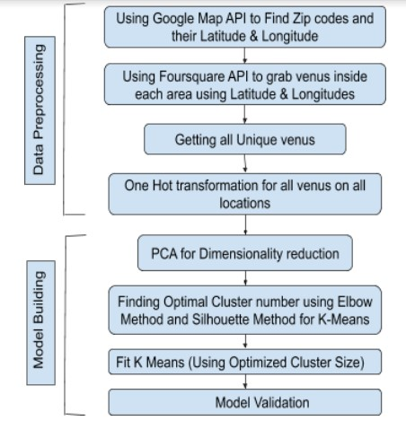
Workflow
Fig 1. Neighborhood segmentation work flow chart

Slide 5
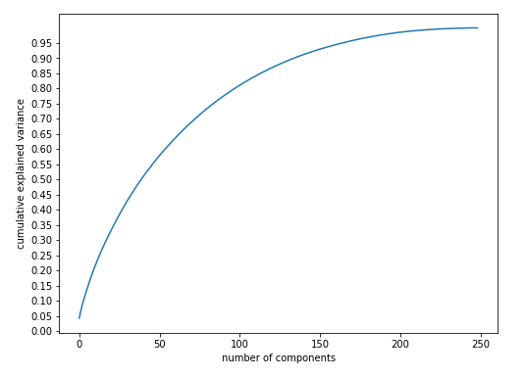
Selecting Principal Components
Applying PCA Components analysis will reduce the number of variables to a smaller set but
Confining all the attributes of neighborhoods
Figure 2. Selecting Principal Components

Slide 6
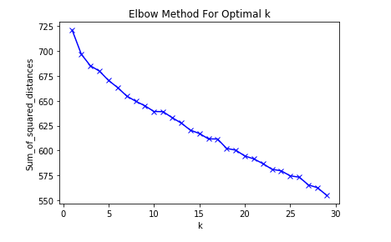
Elbow Method
Through Elbow method determine the optimal number of clusters
Figure 3. Elbow found at k =5 (K is number of Clusters)

Slide 7
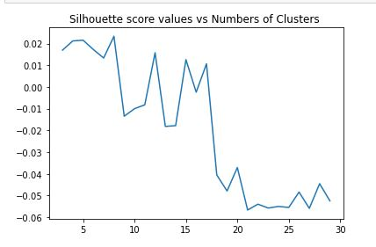
Silhouette Score
Through Silhouette score validate optimal number of clusters
Figure 4. Silhouette Score confirms optimal Cluster Number

Slide 8
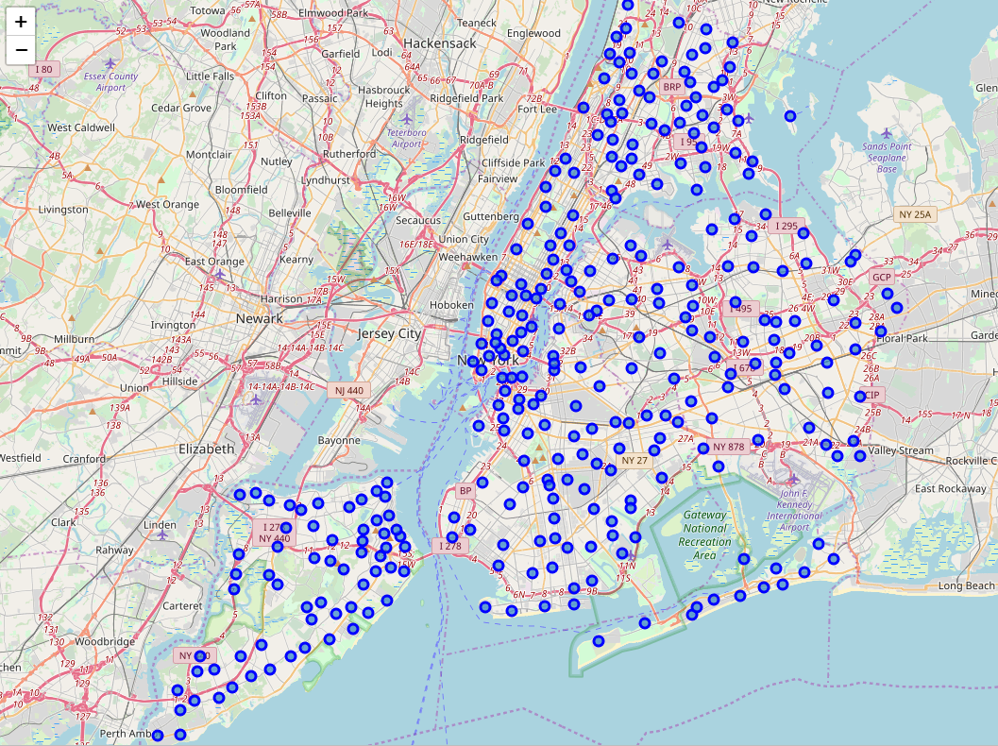
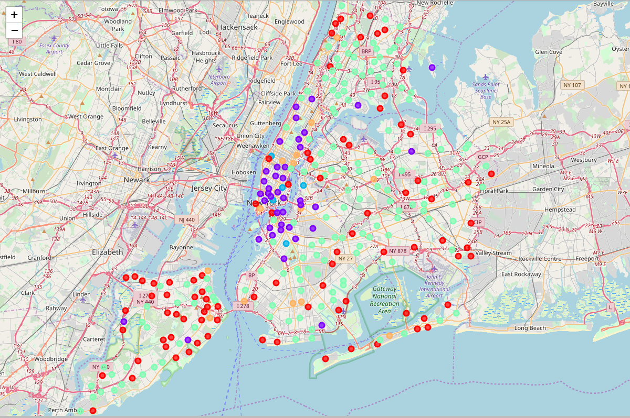
Cluster Visualization
Before Clustering
After Clustering
Figure 5. Manhattan, NY neighborhoods with the assigned cluster label

Slide 9
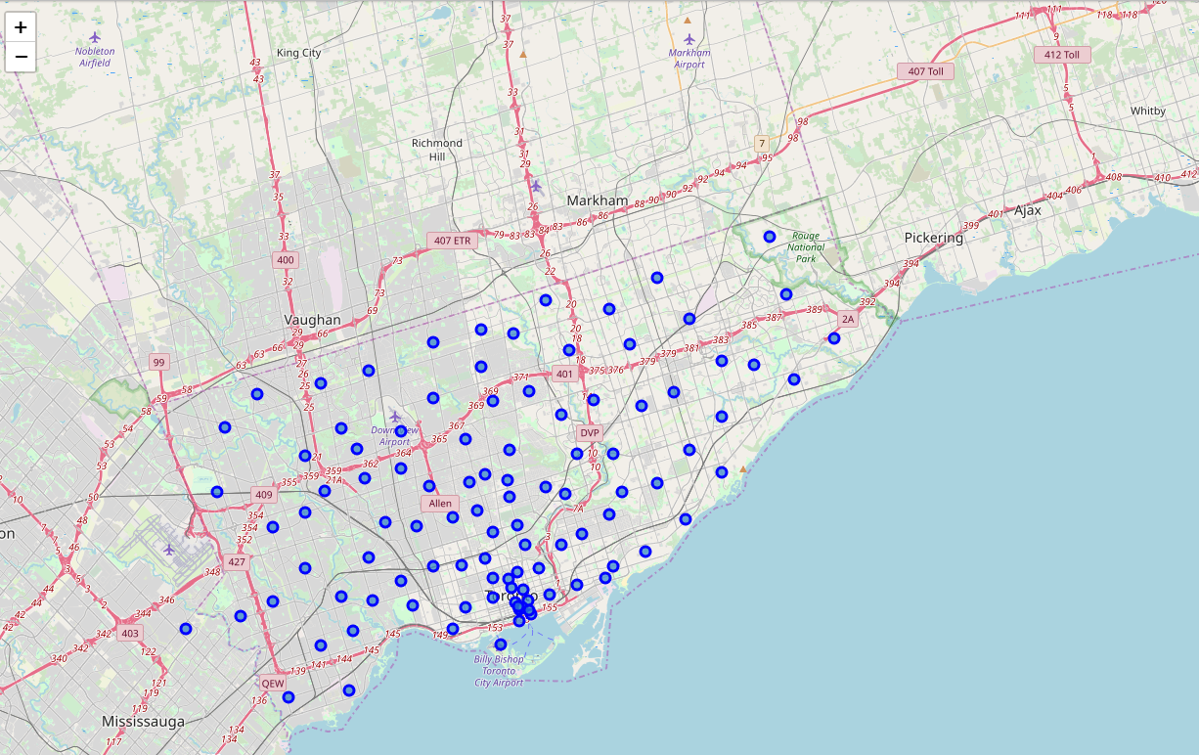
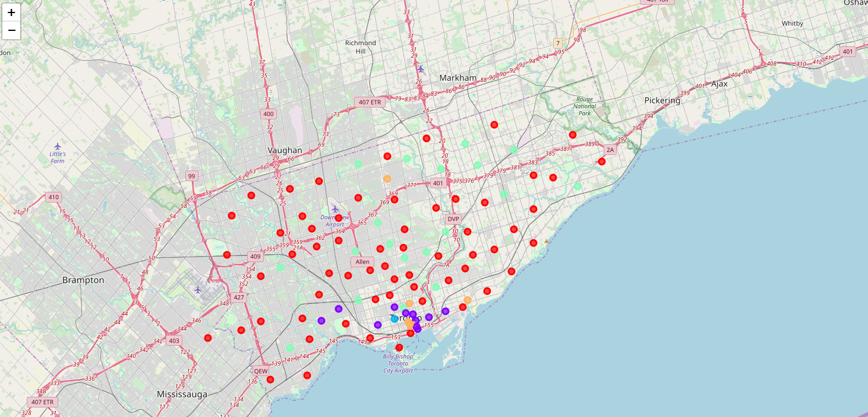
Cluster Visualization
Before Clustering
After Clustering
Figure 6. Toronto neighborhoods with the assigned cluster label

Slide 10
Comparison of neighborhoods
First column is the cluster ID, second column is the number of neighborhoods of Manhattan NY that matches the attributes for cluster 1, third column is for the Toronto neighborhoods
Cluster ID | Manhattan, NY no. of Neighborhoods | Toronto No. of Neighborhoods
1 | 16 | 0
2 | 108 | 36
3 | 54 | 8
4 | 0 | 2
5 | 127 | 4
A person living in a neighborhood in cluster <i> can move to any neighborhood of Manhattan NY which has the same attributes for that cluster. Here i is in {1,2,3,4,5}.
Ref: https://github.com/nazrulcse2k/data_science_nazrul/blob/master/NY%20vs%20Toronto.ipynb

Slide 11
Observations
If Mr. X lives in any neighborhood of Toronto bearing the attributes of either Cluster 2 or 4 then he will have a lots of choices in Manhattan, NY to choose as new neighborhood.
If Mr. X lives in a neighborhood of Toronto under cluster 3 then he will still have choices from Manhattan but options are not at large as others.
If Mr. X lives in a neighborhood of Toronto under cluster 4 then he will not have much choice to make, he will have to choose some neighborhood in Manhattan based on some other options.
Ref: https://github.com/nazrulcse2k/data_science_nazrul/blob/master/NY%20vs%20Toronto.ipynb

Slide 12
Conclusion
The project work was only done on the zip codes of New York and Toronto, which includes 401 zip codes each having 150 features even after dimensionality reduction with PCA. If features are increased as well as cluster numbers then Mr. X may have more options to choose for each cluster.
Note that we have a huge feature space but limited number of samples. We can collect data from entire United States and Canada, which will make our dataset well balanced and model can be applied for relocation problem between US and Canada.
From figure 5 and 6, one can spot certain outlier in our data. Those outliers can be more fine-tuned applying adaptive machine learning rules for more robust clustering.

Slide 13
THANK YOU

